Slide 1

Team : 06
Food brand understand customer trend
GUIDANCE BY : PAVITHRA KANNAN MAM

Slide 2




Team Members
JAGRUTI DESALE
SANSKAR CHOUDHARI
ADITYA SINGH

Slide 3

Project Introduction
Food delivery platforms like Swiggy and Zomato generate huge volumes of customer feedback in the form of ratings, reviews, and order data. This feedback contains valuable insights about customer preferences, satisfaction levels, and product performance. However, businesses often fail to leverage this raw data effectively due to its unstructured nature.
Our project aims to analyze customer feedback using Power BI to transform ratings into meaningful insights. We classified customer feedback into Positive, Average, and Negative sentiments, enabling a deeper understanding of customer experiences.

Slide 4
Project Overview
Focus on analyzing customer behavior toward food brands using collected data.
Utilized Power BI for visualization and analysis.
Identified seasonal trends, demand patterns, and brand performance.
outcome
Understanding customer preferences for better business decisions.

Slide 5
Key Features
Collection & preprocessing of sales and customer feedback data.
Sentiment analysis (Excellent>4.5, Good>4, Average>3.5, Poor).
Price categories (Low: <300, Medium: 300-600, High: >600, premium: >1000)
Delivery Speed (Fast: <45 Min, Medium: 46-60 Min, Slow: >60 Min)
Interactive Power BI dashboards with charts, filters, and drill-downs.
Price-wise and product-wise comparison.
Region-based and demographic insights.

Slide 6



Milestones
Team : 06
Customer Segmentation
Segmentation logic based on sentiment behaviour
Team Members
JAGRUTI DESALE
SANSKAR CHOUDHARI
ADITYA SINGH

Slide 7

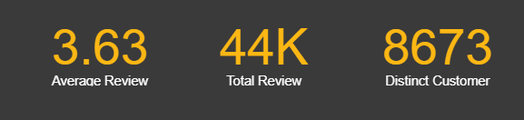
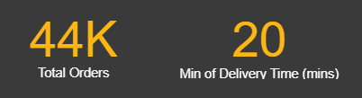
Objective of Milestone 4
Detailed Analysis : The Story Behind the Numbers
Objective : While stable, 3.63 is the most critical metric that needs improvement.
We processed 44,000 orders across 8,673 customers and average review is 3.63.
Segmentation objective : identify “Loyal customers”, “Critics”, and “Silent Users” and make segments actionable.
Deliverable : cluster model + dashboards with slicers for region, customer persona, and cuisine popularity.
Power BI KPIs :
Total Orders Processed : 44,000
Distinct Customers : 8,673
Nearly every order has a customer review.
Average Review Score : 3.63

Slide 8

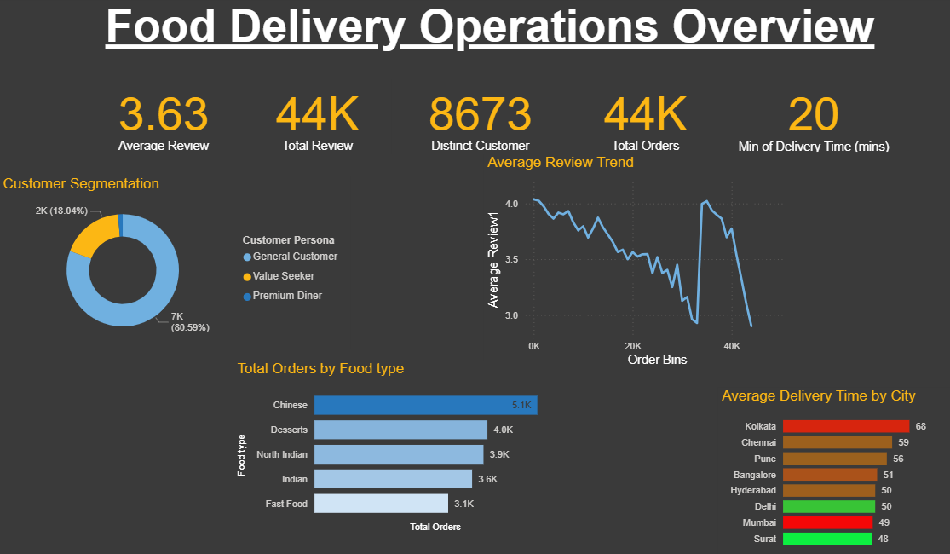
Parameters Used for Segmentation
Data Inputs and Segmentation Parameters
Key Insights :
Data sources : Orders table, Reviews, Customer profile (age, region, channel), Product metadata (cuisine, price)
Donut chart shows customer breakdown by segment.
Identified segments: Premium Diners and Value Seekers.
Over 80% of customers fall into the “Other” category.
The donut chart on the left shows our customer breakdown. While we've identified 'Premium Diners' and 'Value Seekers’, It's clear that the vast majority of our user base—over 80%—falls into a general 'Other' category. This indicates a massive opportunity to further analyses this group and create more targeted marketing strategies.

Slide 9
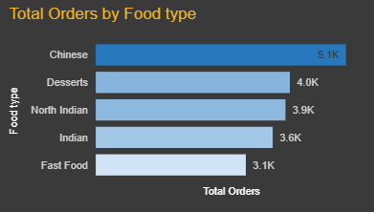
Operational Performance
The What and Where
Key Insights : The bar charts at the bottom reveals our operational realities.
By Food Type, Chinese cuisine is the clear driver of order volume, which tells us where our core demand lies.
More critically, the Delivery Time by City chart, which is sorted by longest time, highlights our biggest challenge. Kolkata and Chennai have the slowest delivery times at 68 and 59 minutes, respectively. This is significantly longer than our best-performing cities like Surat (48 minutes) and needs to be our top operational priority.
Bar charts show Operational Performance by Food Type and City.
Chinese cuisine drives the highest order volume.
Delivery Time by City (sorted longest to shortest): Kolkata – 68 minutes
Chennai – 59 minutes
Surat – 48 minutes (best performing)

Slide 10
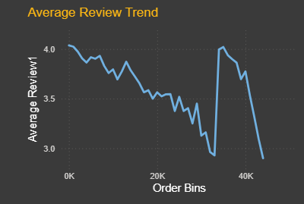
The Average Review Trend
The “How”
Key Insights : The bar charts at the bottom reveals our operational realities.
The line chart in the centre is perhaps the most important story. It shows that despite our overall average review being 3.63, the trend over time is concerning. We started strong with ratings above 4.0, but have seen a steady decline
The sudden spike and subsequent drop near the 35K order mark is an anomaly we should investigate—it could be tied to a specific marketing campaign or an operational change that we can learn from.
This trend signals quality consistency issues as we scale, and the anomaly requires investigation.

Slide 11
Conclusion & Actionable Insights
Actionable Insights
Key Insights : The dashboard indicates a healthy business overall. However, it highlights two urgent focus areas :
1. Operations : Investigate and address the root causes of slow delivery times, starting with Kolkata.
2. Customer Satisfaction : Analyze the decline in average reviews and take steps to reverse the trend.
This dashboard will help track progress and make data-driven decisions to improve both customer satisfaction and operational efficiency.

Slide 12
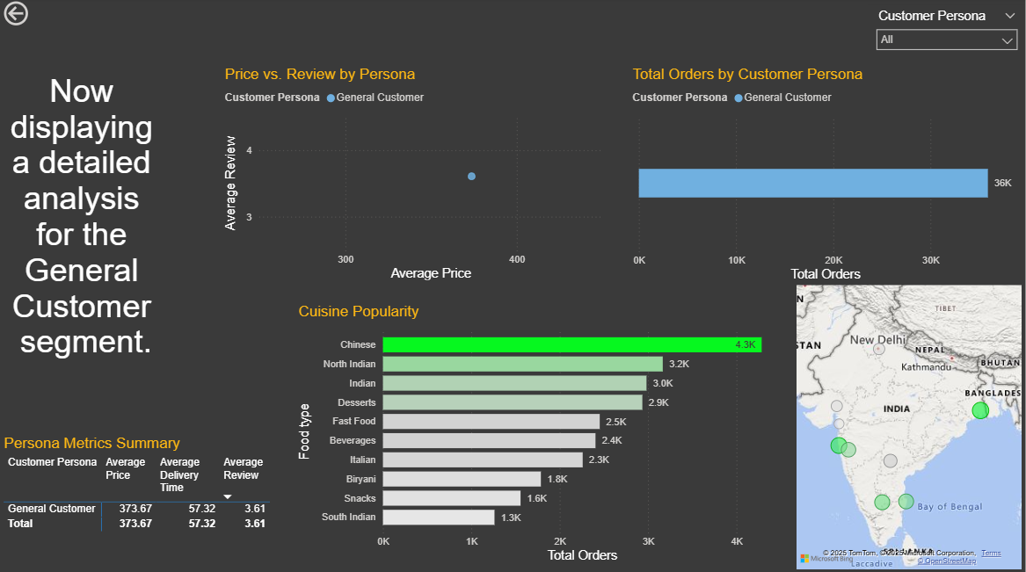
Executive Summary
Executive Summary : A Detailed Overview
Objective : Detailed breakdown of our customer base, revealing three distinct operational segments.
The key insight is that while over 80% of our business comes from a 'General Customer' base with a baseline satisfaction score of 3.61, our most profitable and satisfied customers are a niche 'Premium Diner' segment, who spend nearly four times as much and rate us at a very high 4.31.

Slide 13

The Detailed Walkthrough
The Story Behind the Data
1. Understanding Our Customer Mix
First, let's look at who our customers are. The 'Total Orders by Customer Persona' chart shows that our customer base isn't uniform. The vast majority are what we've now defined as the 'General Customer'—this is the backbone of our order volume. Alongside them, we have our two strategic segments: the cost-and-speed focused 'Value Seekers' and the quality-focused 'Premium Diners’.
2. What Defines Their Behaviour ?
Our Premium Diners are in a class of their own, spending an average of ₹1,280 per order and giving us our highest satisfaction score of 4.31.
The General Customer represents our baseline, with an average spend of ₹374 and an average review of 3.61. This is the core experience we provide to most users.
The Value Seekers are the most price-sensitive and have the fastest delivery times, confirming their focus on efficiency."

Slide 14
The Detailed Walkthrough
The Story Behind the Data
3. The Price vs. Satisfaction Curve
This relationship is visualized perfectly in the 'Price vs. Review' scatter plot. It shows a clear positive correlation: as average spend increases, so does customer satisfaction. The Premium Diners are a clear outlier in both value and satisfaction, demonstrating the success of our premium offerings.
4. Operational Context
The 'Cuisine Popularity' chart shows that Chinese food is the most ordered category, giving us insight into customer tastes. The 'Total Orders by City' map shows our key markets, allowing us to focus operational improvements where they'll have the most impact.

Slide 15
Final Conclusion & Actionable Insights
This analysis provides us with a clear, data-driven path forward.
Key Insights : This analysis provides us with a clear, data-driven path forward :
1 . The Volume Opportunity: Our largest opportunity is to elevate the experience for the 'General Customer'. Even a small increase in their 3.61 average review would significantly lift our overall score. We can use this dashboard to drill down into their specific preferences and locations to find opportunities for improvement.
2 . The Value Opportunity: Our 'Premium Diner' segment is our most profitable. We should immediately focus on targeted marketing and loyalty campaigns to retain these high-value customers and find more like them.
3 . The Niche Opportunity: While 'Cuisine Explorers' didn't emerge as a large segment, we now have a robust framework to identify and cultivate niche customer groups in the future.

Slide 16

Thank you
Team : 06
We appreciate the opportunity to present our project on Customer Sentiment & Food Trend Analysis. Your feedback and suggestions will help us improve and take this work further.
Thank you for your time and attention!

